Slide 1
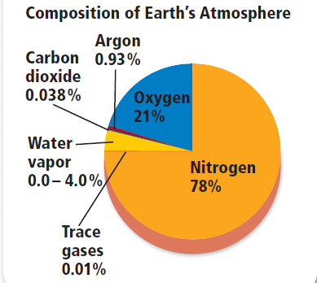
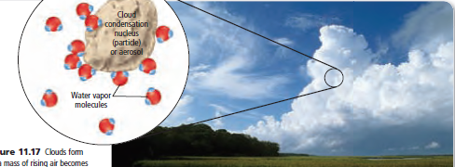
T-1: Introduction to Climatology and Atmosphere
Definition, Nature and Scope
Importance of Climatology in modern time.
Weather and Climate, Elements of Weather and Climate
Composition and Structure of Atmosphere.
M S Jadhav
Department of Geography
Ahmednagar college, Ahmednagar
Station Road
Ahmednagar-414001
jadhavgeo@gmail.com
9730145311

Slide 2
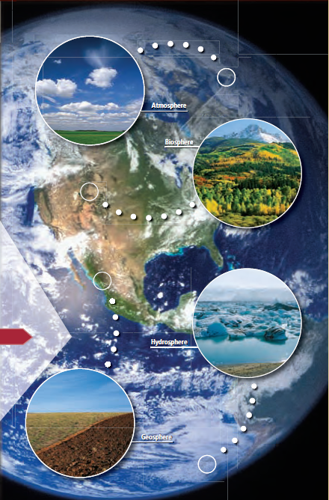
CLIMATOLOGY-DEFINATION, NATURE AND SCOPE
The study of the Earth falls into four broad categories:-
The solid lithosphere
The liquid hydrosphere
The gaseous atmosphere
The life biosphere
Geo/Litho sphere: The area from the surface of Earth down to its center is called the geosphere.
Atmosphere: The blanket of gases that surrounds our planet is called the atmosphere.
Hydrosphere :All the water on Earth, including the water in the atmosphere, makes up the hydrosphere.
Biosphere: The biosphere includes all organisms on Earth as well as the environments in which they live.

Slide 3
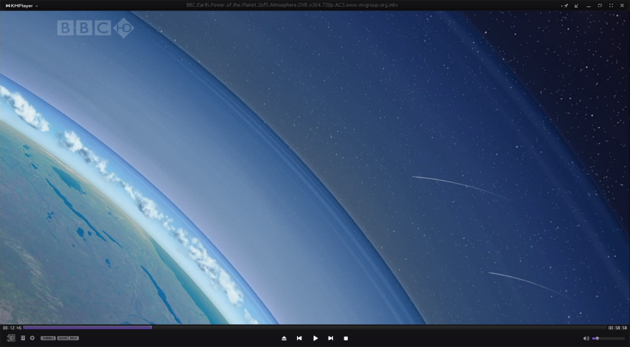
Climatology:
Climatology studies the gaseous atmosphere
Climatology is the science of climate which study the Physical state of the atmosphere:-
--over a specific region
--during a specific period
--on the basis of climatic data
Climatology is compounded of two Greek words……..,
Klima and Logos
--Klima- meaning inclination that is latitude
--Logos-meaning science of study

Slide 4
So, climatology is a science that seeks to
describe and explain:-
the nature of climate
❑ why it differs from place to place
how it is related to other elements of the
natural environment and human activities
It is the study of the verities of climates found on the Earth and their distribution over the surface of the Earth

Slide 5
CLIMATOLOGY AND METEOROLOGY
Climatology is closely related to meteorology
Meteorology deals with the day to day atmospheric
conditions and their causes
Meteorology is defined as the Physics of the
atmosphere
Meteorology uses the methods of Physical science to interpret and explain the atmospheric processes
Meteorologically it deals with the meteorological techniques and geographically it deals with the spatial aspects of climatic phenomena
Climatology collects and interpret the data observed by meteorology to investigate the spatial patterns of climate and its interaction.

Slide 6
CLIMATOLOGY AND GEOGRAPHY
➢ Since geography studies the Earth as the habitat
of Man it is closely related with climatology;-
➢ Climatology studies the atmospheric conditions
➢Geography studies the spatial distribution of these climatic condition
➢ Through the study of climate, it serves the ends of geography, while the means employed by it are those of meteorology
➢ Climatology is a science whose methods are strictly meteorological and whose aims and results are geographical.

Slide 7
DEFINATIONS OF CLIMATOLOGY
Climatology is the science of climate which study the Physical and spatial state of the atmospheric conditions
According to Critichfield:-
‘climatology is the science that seeks to describe and explain the nature of climate, how it differs from place to place and how it is related to man’s activities.’
According to Austin Miller:-
‘Climatology is that branch of science which discusses the average conditions of weather.’

Slide 8
According to Koppen and De Lang:-
‘Climatology is a summery, a composition of weather conditions over a long period of time.’
According to Thornthwaite:-
‘Thornthwaite broadens the scope of climatology and suggest that it is the study of the atmosphere as well as the Earth’s surface.’
Climatology is the science of studying long-term weather trends. Its focus is on averages of weather and climatic conditions over a long period of time in local, regional and global locations

Slide 9
Nature of Climatology:
1. Descriptive
2. Dynamic
3. Scientific
4. Interdisciplinary
5. Applied
6. Complex

Slide 10
Descriptive Nature:
In ancient period, Greeks geographers study and describe nature of
atmosphere and its influence on human health and culture.
Hippocrates(BC400), in his written document “Air, Water and Place”
where he descried the influence of climate on health.
Theophrastus described different aspects of wind
Ancient Greek described three temperature zone based on latitude…
i) tropical zone, ii) temperate zone, iii) frigid zone
The knowledge of weather and climate up to 16th century was
descriptive.
Because qualitatively observed data and description by
non-professional individual.
2. Age of Discovery and Exploration: (15th to 16th) Dynamic
Discovery and exploration of new areas and there features of weather and climate.
Study of weather and climate out side the Europe.

Slide 11
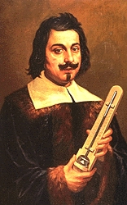
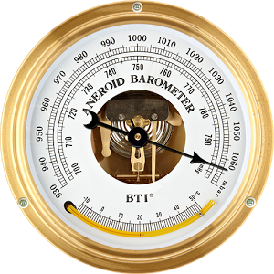
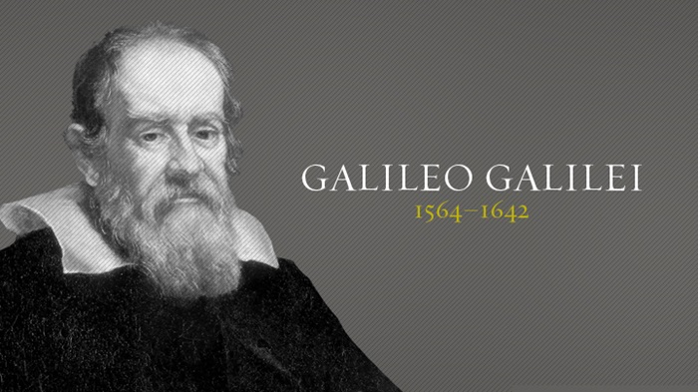
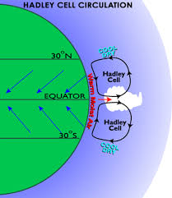
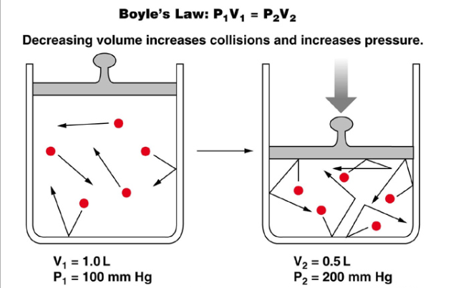
3.Scientific Nature: (Period Scientific Analysis)
Climatology as science blossomed in 17th century when few instrument invented to measure climatic variable.
Measurement and recording of temperature started with invention of thermometer…… by Galileo In 1593 and by Santorre in 1612.
Measurement of Pressure started with invention of barometer by Torricelli in 1643.
availability of data on temperature and pressure leads to formulation of few laws about atmospheric condition.
Ex…..
Francis Bacon’s treatise on wind in 1662, Boyle’ law about the air
pressure and atmospheric gases.
Hadley’s cell model on tropical circulation in 1735 know as Hadley
Cell

Slide 12
Period of Regional Description: (18th and 19th )
This period is characterized by study of weather phenomenon at
regional and global levels
Efforts were made to preparer maps of the countries, continents,
and glob.
Depicting climatic variables like… insolation, temperature, air
pressure, and wind, atmospheric disturbances, precipitation etc..
Description of all variable of climate and weather of different
regions of world.
Luke Howard, 1803, presented well documented on classification
of clouds.
IMC : (International Meteorological Committee) in 1895.
WMO: World Meteorological Organization- published
international Clouds atlas.
Alexander Von Humboldt in 1817 prepared World map of mean
annual temperature using isotherms

Slide 13
Interdisciplinary- Applied and Complex:
Modern nature: Period of Modern Climatology (20th century):
climatology reached to study upper circulation and weather
phenomena , information obtained through advanced techniques.
Period was marked by
Advancement in techniques to obtained detailed regular climatic data.
Concentration on classification of world climate.
Concerned about the climatic changes.
Weather forecasting.
International cooperations to tackle the future problems of
climatic changes at local, regional and global levels caused mainly
by anthropogenic factors.
*Stratosphere and Ozone layer discovered in 1902,1913 respectively
*Jet Stream during IInd Word War
*Satellite Climatology as new branch and first meteorological satellite
TIROS 1, SUA launched in 1960.
*Decade:1940- Characterized as development of Synoptic Climatology.
*Schema of Classification of World Climate-Waldimir Koppen, Geigger Pohi C W
Thornthwaite

Slide 15
IPCC and concentration on the study of green house gas as cues of the increase of global mean temperature by 20c above mean global temperature of pre-industrial period by 2030A.D.
It will lead to the drastic climate changes affecting all the biota.
The climate change will be the major agenda in the present century.
Nature of Climatology:
1. Descriptive
2. Dynamic
3. Scientific
4. Interdisciplinary
5. Applied
6. Complex

Slide 16
Scope of Climatology:
Content or Scope of any discipline largely depend on its aims and objectives.
The scope covering all the contents of climatology may be described through its major
Branches i.e…..
Physical and Dynamic climatology
Regional Climatology
Applied Climatology

Slide 17
Physical & Dynamic climatology:-
Physical climatology:--deals largely with energy exchanges and physical processes.
Dynamic climatology is more concerned with atmospheric motion and exchanges lead to and result from that motion
- seeks to explain the factors responsible for bringing out the temporal and spatial variations in heat exchange, moisture exchange and air movement
-- Physical climatology is closely related to meteorology
-- Physical climatology is a main aspect meteorology from which most
of its basic principles are drawn
-- the focus is on:-
The study of solar energy- its transformation at a location and its
transfer through the atmosphere
The complicated patterns and exchange of energy from one phase to another- from solid state to liquid state and from liquid state to vapor and vice versa

Slide 18
Dynamic climatology:-
--is global in scope
--it studies the thermodynamic processes in the
atmosphere and the resultant atmospheric motions
--it investigate the impact of changes in various physical
parameters on climate
--this branch of climatology includes:-
The effect of the increase of greenhouse gases in
global temperature
the role of mountains in determining the dynamics of the atmosphere
An investigation into sea-surface temperature
iii.

Slide 19
Synoptic climatology:-
--deals with local or hemispheric climate from
the view point of atmospheric circulation
--different circulation patterns lead to
differences in climates
--it studies the relationship between circulation features and severe weather conditions-E.g.- the effect of El Nino and La Nina in creating severe weather conditions

Slide 20
Regional climatology:-
-- This branch of climatology seeks to determine
and describe the various types of world climates
--it is also known as descriptive climatology because it is concerned with the identification of important climatic characteristics and the interaction of weather and climatic elements upon the life, health and economic conditions of the people and areas

Slide 21
Applied climatology:-
-- This branch of climatology is concerned with the application of the climatological knowledge to practical problems
-- It analyses the relationship of climatology to
other sciences
--The main purpose is to find out the ways and means to make use of our knowledge of climatic elements for the betterment of human life on the Earth

Slide 22
THANH YOU

